Slide 1
Essay

Slide 2
Goals
To develop a deeper understanding of essay writing and to have hands-on practice of:
1. Main Parts of an essay
2. Different patterns to organise your essay:
Chronological order
Cause/Effect
Comparison/Contrast
Argumentative

Slide 3
Main Parts of An Essay

Slide 4
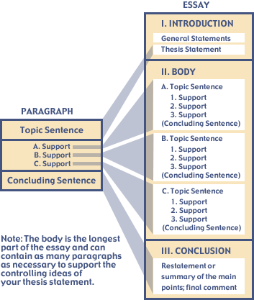
The basic essay structure
Notes:
Source: https://learn.solent.ac.uk/mod/book/view.php?id=2735&chapterid=1787

Slide 5
Step 1: Outline
Could you work out the outline of the sample paper?

Slide 6
Titles
What is the Purpose of a Title?
Indicate the subject of your research.
Distinguish your research from others of its kind.
Show continuity with preceding papers. （以前论文的延续）
Provide key words for indexing.

Slide 7
Titles
Titles in scholarly writing follow a very clear pattern. They generally consist of 3 components (below). They should give the reader a good sense of what the scholarly paper's substance is, and therefore are best decided upon near the end of the essay-writing process.

Slide 8
Titles
A. A Catchy “Hook”
This, the least important part of an academic title, introduces the paper in a creative way.
Strength through Joy
Workers in the Wild
The Emergent Queer（weird）

Slide 9
Titles
B. Topic Keywords
The "what" of the paper. This identifies concepts the scholar will be exploring.
Consumerism（消费主义） and Mass Tourism
Homosexuality（homo单个，单词意思同性恋） and Nigerian Fiction
Conservation, Consumerism, and Labor

Slide 10
Titles
C. Specific Focus Keywords
The "where/when" of the paper.
...in Early National New England
...in the 21st Century
...in Mallarme

Slide 11
Titles
Examples
“Buy Me a Date（海枣）: Consumerization and Theories of Social Interaction in 21st Century Online Daticng Sites”
"Just Do It: Risk-Taking and Collaborative Learning Theory in Multiplayer Video Games“
"Is That a Horseshoe in Your Pocket?(暗示困难) Homosocial Male Archetypes（典型） in the the Cowboy Western"

Slide 12
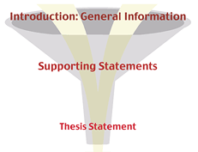
Step 2: Introduction
Funnel introduction
Thesis: (formal) a statement or an opinion that is discussed in a logical way and presented with evidence in order to prove that it is true.
Notes:
Source: https://web2.uvcs.uvic.ca/encomium/writingdemo/wa/unit1/u1_l1b_a.htm

Slide 13
Funnel Introduction
General information
is a HOOK to catch the reader’s attention
should be a broad, general statement that does not mention your topic
Supporting statements
narrows down the broad, general statement
leads to and supports your thesis
Thesis statement
is usually the last sentence
tells exactly what the whole paper is about

Slide 14
An example of the funnel introduction
Mankind has always been a complaining species. Every generation claims to have hardships not encountered（遇到） by other groups. In the twentieth century, however, one group's complaints are completely justified. Evidence clearly shows that modern teenagers do, in fact, have a very difficult life.

Slide 15
Thesis statement pitfalls
The thesis is too general.
E.g., Higher education is critical to a country’s development.
It makes a simple announcement.
E.g., I am going to discuss how to write a journal article.
It states an obvious fact.
E.g., Doing exercise regularly is good for our health.
Can you find the thesis statement in the sample paper?
Do you think it is a good one?

Slide 16
Sample Writing Introduction
Education means considerably more than just teaching a student to read, write, and manipulate numbers. Computers, the Internet, and advanced electronic devices are becoming essential in everyday life and have changed the way information is gathered. How this new technology is utilized in the curriculum and managed by teachers will have an important role to play in widening the resource and knowledge base for all students. Technology affects the way teachers teach and students learn. To make the best use of information technology (IT), schools need a workable plan to fully integrate it into all aspects of the curriculum so students are taught how, why, and when to use technology to further enhance their learning.

Slide 17
Hooks and attention grabbers(第一句+最后一句+标题)
An “attention getter”, also known as an “attention grabber” or “hook”, refers to the first 1-4 sentences of an essay. On average, people only read the first 2 sentences before deciding if your essay will be an interesting read or a chore.
Examples of attention grabbers
A definition | A quotation | A striking fact | A comparison
A question | A story | A joke | Striking numbers/statistics

Slide 18
Step 3: Body paragraphs
Given the thesis statement in the Introduction, there are two major keys to organising the body paragraphs:
Discuss one main point in a separate paragraph.
Use transition signals between paragraphs to guide your reader

Slide 19
Concrete support
Literature review/citations
summarising, paraphrasing or quoting the source documents
Reasons
Examples
Statistics

Slide 20
Step 4 The concluding paragraph
Signal the end of your essay. To do so, begin your conclusion with a transition signal.
Rephrase your thesis
Summarise your main points
Provide your reader with some final thoughts (e.g., making a prediction; suggesting a solution, making a recommendation, or calling for an action; quoting an authority on the topic).

Slide 21
Exercise
Scan the sample paper. Discuss in pairs or small groups and evaluate whether it contains the main parts of a typical essay:
Funnel introduction (general information & thesis statement)
Body paragraphs and two major keys
Concrete support
The concluding paragraph

Slide 22
Tips for writing a journal paper
A few resources for your reference
Let’s look at the Abstract part.

Slide 23

Chronological Order

Slide 24
1.
Putting the ideas in order or sequence by occurrence of time
For narrative essays and for process essays (how events happen or how to do/make something)

Slide 25
2.
Three keys to success in writing a chronological order essay
Write a thesis statement indicating the chronological order
Group the steps or events into paragraphs
Use chronological order signal words and phrases to show the sequence of steps (in a process) or events (in a narration)

Slide 26
Transition signals for chronological order
first, first of all, second, third
then, next, after that, soon
finally, last, last of all
meanwhile, at the same time, now
gradually, eventually
as soon as, since, until, when, while, as,
on the third day, for five minutes, in 2004, several years ago, in the next/past/last 10 years, later that morning, after/before leaving home,

Slide 27
Cause/Effect

Slide 28
1.
A common pattern in academic writing to write about causes (or reasons) and effects (or results).

Slide 29
2. Two common ways to organise information
Block organisation
Cause Effects
Effects Causes
The order of them are not critical; the point is to discuss the causes/effects together as a BLOCK.
Illustration（图表、示例）

Slide 30
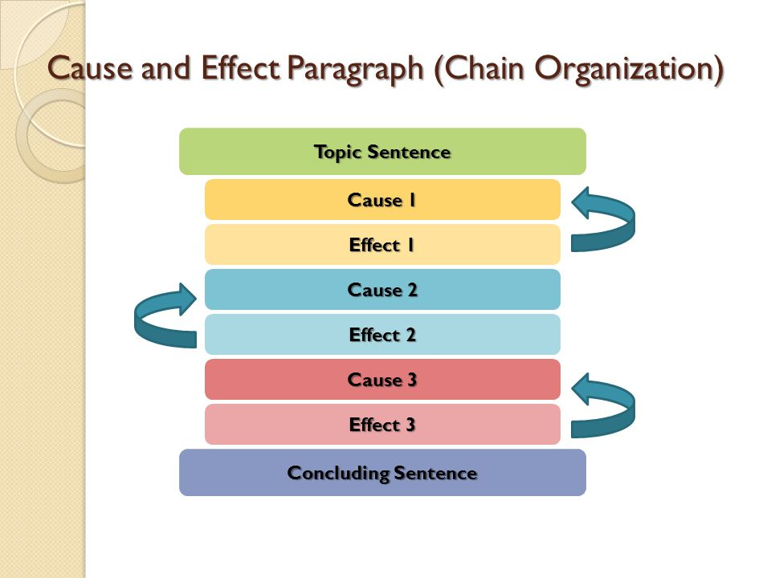
Notes:
Source: https://www.google.com/imgres?imgurl=https%3A%2F%2Fslideplayer.com%2Fslide%2F6097782%2F18%2Fimages%2F21%2FCause%2Band%2BEffect%2BParagraph%2B%2528Chain%2BOrganization%2529.jpg&imgrefurl=https%3A%2F%2Fslideplayer.com%2Fslide%2F6097782%2F&docid=QdJEyT5SWDticM&tbnid=nMKV-LXMCX20iM%3A&vet=10ahUKEwjHoNuh6cfkAhXJQN4KHR5PAr0QMwhLKAowCg..i&w=960&h=720&bih=608&biw=1366&q=cause%20and%20effect%20essays%20block%20organisation&ved=0ahUKEwjHoNuh6cfkAhXJQN4KHR5PAr0QMwhLKAowCg&iact=mrc&uact=8

Slide 31
In the past, most women stayed at home to take care of domestic chores such as cooking or cleaning. Women's liberation and feminism have meant that this situation has been transformed and in contemporary society women are playing an almost equal role to men in terms of work. This has had significant consequences, both in terms of the family, for example by improving quality of life and increasing children's sense of independence, and also for society itself with greater gender equality.

Slide 32
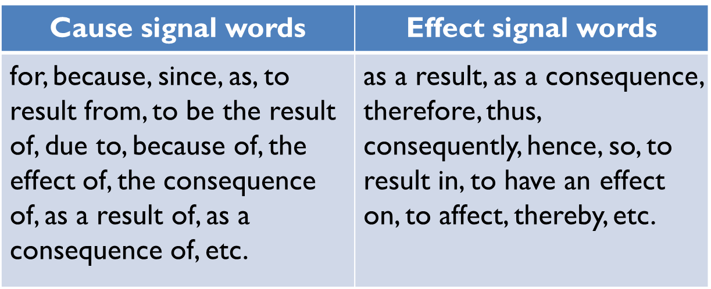
3.
Use a variety of signal words to help the reader to follow your ideas.

Slide 33
Comparison/Contrast

Slide 34
1.
A common pattern for writing about similarities and differences. It is used in all academic fields.

Slide 35
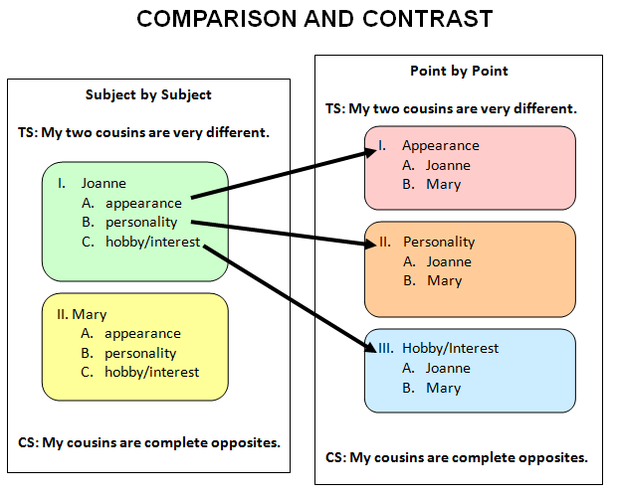
Notes:
Source: https://www.google.com/imgres?imgurl=https%3A%2F%2Fi.pinimg.com%2Foriginals%2Fb3%2F1a%2Fe3%2Fb31ae3c53608d696ac000693b83e42be.png&imgrefurl=https%3A%2F%2Fwww.pinterest.com%2Fpin%2F360147301449172440%2F&docid=9myBveeR1vtHuM&tbnid=DiKUFixc1ytgQM%3A&vet=10ahUKEwj3qN-N6cfkAhUEfd4KHQPYCVYQMwg_KAIwAg..i&w=621&h=499&bih=608&biw=1366&q=comparison%20and%20contrast%20point%20by%20point&ved=0ahUKEwj3qN-N6cfkAhUEfd4KHQPYCVYQMwg_KAIwAg&iact=mrc&uact=8

Slide 36
Before the advent of computers and modern technology, people communicating over long distances used traditional means such as letters and the telephone. Nowadays we have a vast array of communication tools which can complete this task, ranging from email to instant messaging and video calls. While the present and previous means of communication are similar in their general form, they differ in regard to their speed and the range of tools available.

Slide 37
3.
Use signal words to help the reader understand your points of comparison and contrast.
Comparison signal words | Contrast signal words
similarly, likewise, also, too, as, just as, both… and, not only… but also, neither… nor, (just) like, similar to, the same as, etc. | Concession: however, nevertheless/nonetheless, although, even though, though, yet, despite (+ noun), in spite of (+noun), etc. Direct opposition: in contrast, on the other hand, on the contrary, while, whereas, but, differ (from), different (from), dissimilar to, unlike, etc.

Slide 38
Argumentative essays

Slide 39
1.
An argumentative essay is an essay in which you try to persuade the reader to agree with your opinion about a controversial topic.

Slide 40
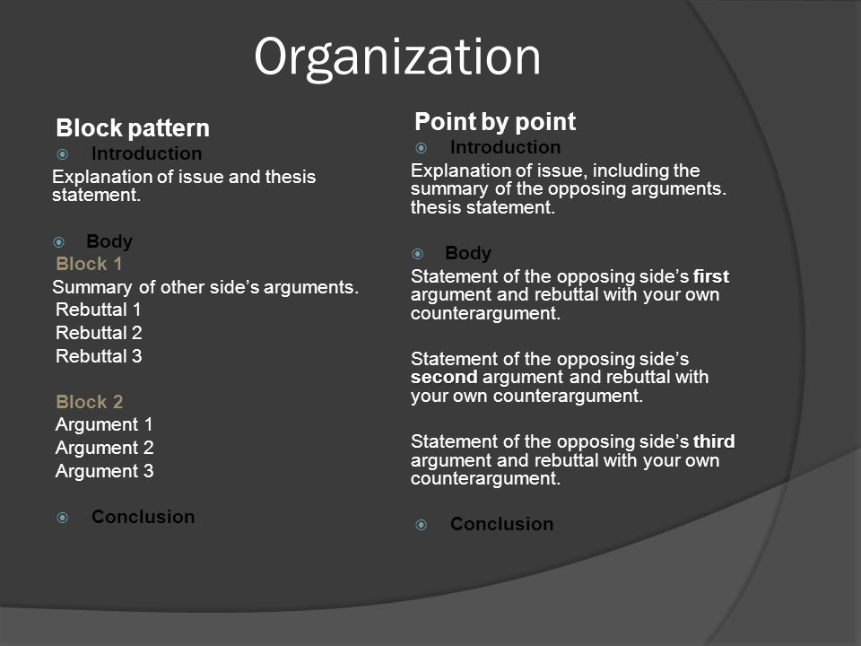
Notes:
Source: https://www.google.com/imgres?imgurl=https%3A%2F%2Fslideplayer.com%2Fslide%2F7779698%2F25%2Fimages%2F6%2FOrganization%2BPoint%2Bby%2Bpoint%2BBlock%2Bpattern%2BIntroduction.jpg&imgrefurl=https%3A%2F%2Fslideplayer.com%2Fslide%2F7779698%2F&docid=qa9Ns_ELrkm6XM&tbnid=CVBbPjzOcUEe4M%3A&vet=10ahUKEwj3jMHJ6cfkAhWC-mEKHQLsBuQQMwhDKAIwAg..i&w=960&h=720&bih=608&biw=1366&q=argumentative%20essays%20block&ved=0ahUKEwj3jMHJ6cfkAhWC-mEKHQLsBuQQMwhDKAIwAg&iact=mrc&uact=8

Slide 41
3.
Key elements of argumentative essays
1. Explanation of the issue
2. A clear thesis statement (stating which side you are for)
3. Presentation of the opposing statements
4. Rebuttals to the opposing arguments
5. Your own arguments
Now let’s look at an example.

Slide 42
History shows that human beings have come a long way from where they started. They have developed new technologies which means that everybody can enjoy luxuries they never previously imagined. However, the technologies that are temporarily making this world a better place to live could well prove to be an ultimate disaster due to, among other things, the creation of nuclear weapons, increasing pollution, and loss of animal species.

Slide 43
The biggest threat to the earth caused by modern human activity comes from the creation of nuclear weapons. Although it cannot be denied that countries have to defend themselves, the kind of weapons that some of them currently possess are far in excess of what is needed for defence. If these weapons were used, they could lead to the destruction of the entire planet.

Slide 44
Exercise（作业）
In pairs, choose one of the topics below:
It is worth the expense and risk to make a manned flight to Mars.
The future status of English as the global language is assured.
Decide which side you agree with.
Write a thesis statement.
Make a list of ideas/supporting reasons for both sides of the argument
Decide which suits the topic better, the block pattern or the point-by-point pattern.

Slide 45
Review
Main parts of an essay
Different patterns to organise essays
Chronological order
Cause/Effect
Comparison/Contrast
Argumentative

Slide 46
Homework
Work out your assignment essay OUTLINE using the argumentative essay patterns introduced.
Topic: Some people believe it is crucial to earn high salaries while they still can. Others believe it is important to secure one's long-term career development even though the compensation could be much lower. Which one do you agree? Please use reasons to support your opinion.
Note:
We will be working in pairs next week, please find a partner.

